Slide 1
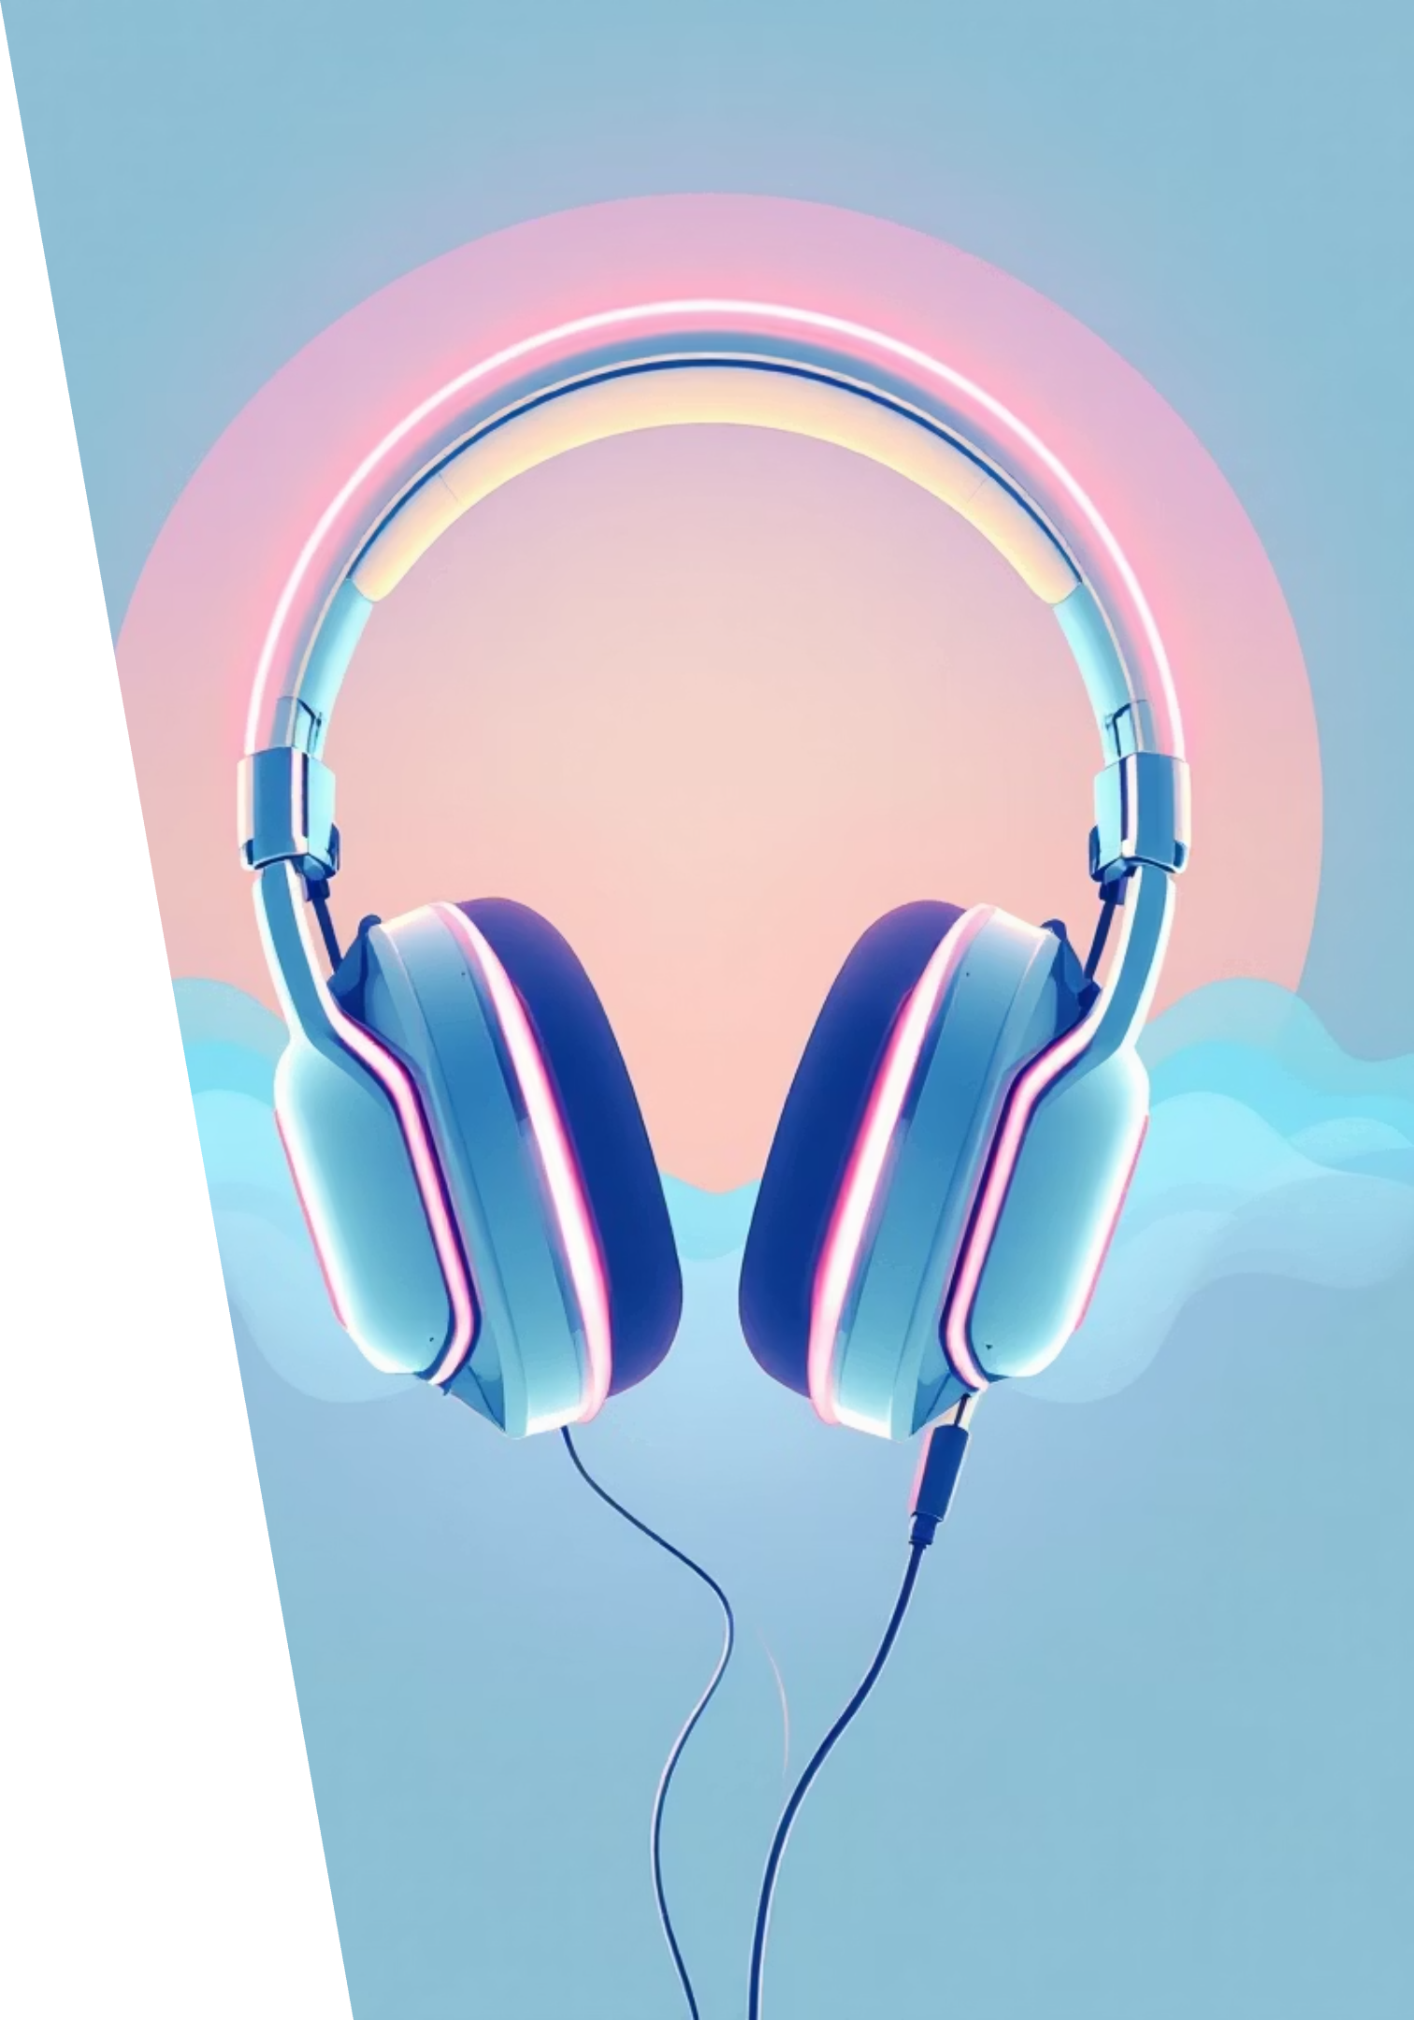
🎧 MuseAI
Personalized Music Discovery & Playlist Curation
An AI-driven music discovery experience designed to understand your mood, curate intelligent playlists, and evolve with your listening journey.

Slide 2


🪄 Project Overview
MuseAI
Tools Used
A personalized music discovery app that understands user moods, recommends songs intelligently, and simplifies playlist curation through an AI-driven experience.
Figma – UI Design & Prototyping
Miro – User Journey & Flow Mapping
Maze / Useberry – Usability Testing
Your Role
Google Fonts (Poppins)
UI/UX Designer
Project Duration: 3-Day Design Sprint
User Researcher
Prototype Developer

Slide 3


💡 The Challenge
The Problem
The Solution
Music platforms offer millions of tracks, yet users struggle to discover songs that truly fit their mood, activity, or personality. Algorithms feel repetitive, and playlist creation is time-consuming.
MuseAI delivers an AI-powered personalized music discovery system that learns from listening patterns, moods, and context — creating playlists that evolve with the user.

Slide 4
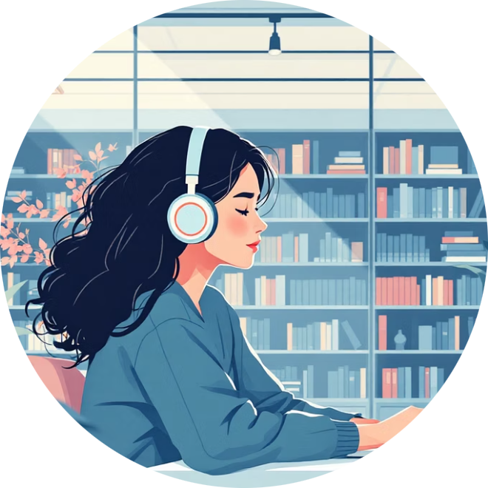
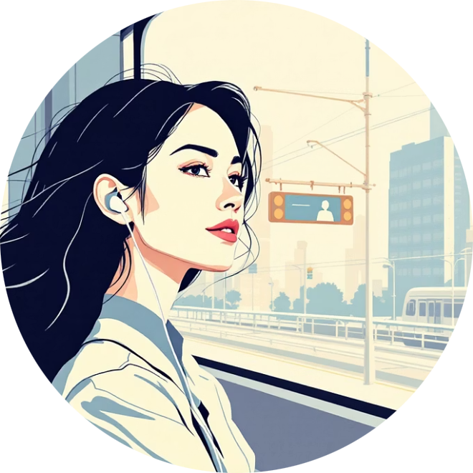





🎯 Understanding Our Users
We identified three primary personas representing our target audience's diverse needs and listening behaviors.
Aarav – The Student
Meera – The Professional
Rohan – The Fitness Enthusiast
Age: 20
Age: 28
Age: 25
Listens while studying or relaxing. Wants calm, Lo-fi, and focus playlists. Frustrated with irrelevant song suggestions that break concentration.
Enjoys mood-based playlists while commuting. Prefers quick, AI-curated recommendations. Finds manual playlist management time-consuming.
Uses music to stay motivated during workouts. Needs energy-based song suggestions with high tempo and driving beats.
Common Pain Points
Repetitive recommendations that feel stale
Time-consuming manual playlist management
Lack of emotional or activity-based personalization

Slide 5
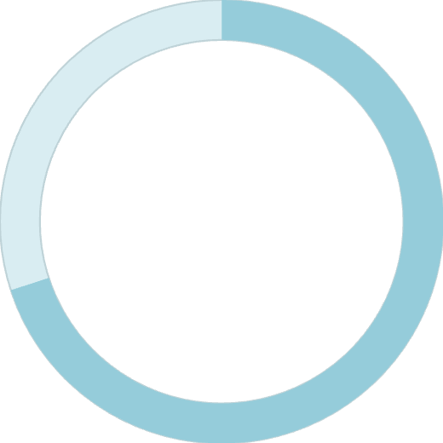
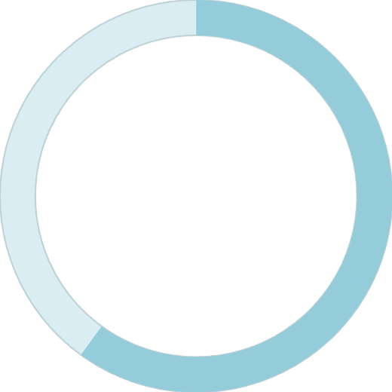

🔍 Research Insights
Research Methods
Key Findings
01
Online Surveys
20 participants across demographics
70%
02
User Interviews
Frequent music app users
03
Mood-Based Music
Competitor Analysis
Users want music based on current mood or activity
Spotify, YouTube Music, Apple Music
60%
Playlist Fatigue
Dislike manually managing playlists
Additionally, users prefer clean, dark-themed music apps with strong accessibility features like high contrast and large, tappable icons.

Slide 6

🗺️ Information Architecture
Entry
Splash Screen
Onboarding
Login / Signup
Discovery
Home (Recommended)
Trending Songs
Mood Types
Song Types (Genres)
Interaction
Search
Playlist Collections
Now Playing
Account
Profile
Settings
The architecture prioritizes quick access to mood-based discovery while maintaining clear pathways to traditional browsing and account management.

Slide 7








🔄 User Journey Mapping
Primary Task: Discover & Play a Song
Launch App
User opens MuseAI
Login
Quick authentication
Home Page
Personalized feed
Select Mood
Choose "Chill"
View AI Playlist
Browse curated songs
Play Song
Like & add to playlist
Secondary Flow
Both flows emphasize speed and intuitive navigation, minimizing steps between discovery and playback.
Home → Trending → Play Song → Add to Favorites

Slide 8


✏️ Wireframe Foundation
Low-fidelity wireframes focused on layout structure and core functionality before visual polish.
Splash Screen
Login/Signup
Logo + Tagline with minimal animation
Basic form with clear CTA button
Home
Mood Page
Search bar, mood chips, personalized playlists
Grid of mood cards (Party, Chill, Focus...)
Player
Profile
Album art + playback controls
Account info + Settings link
Wireframes were drawn in grayscale to focus team discussions on information hierarchy and user flow rather than visual aesthetics.

Slide 9
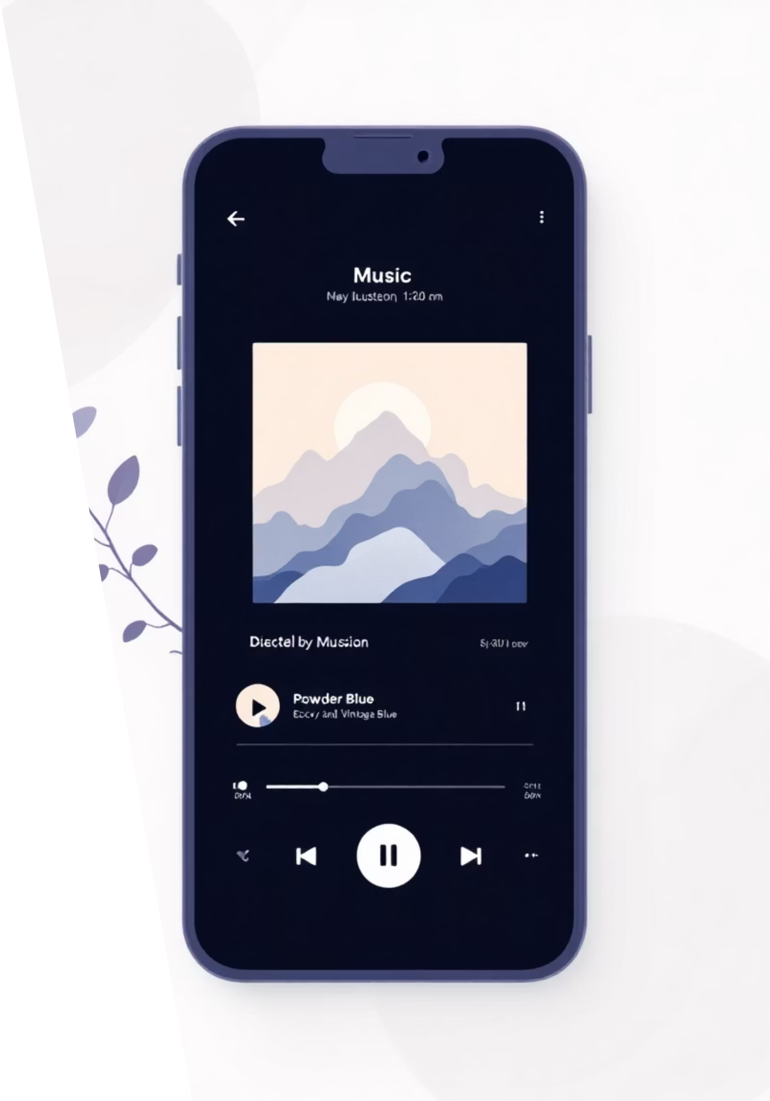
🎨 Visual Design System
Design Theme
Typography
Dark Mode with Neon Gradients
Font Family: Poppins
Glassmorphism for cards and overlays
Heading: 24–32 px Bold
Modern icons with subtle glow effects
Body: 14–16 px Regular
Color Palette
Caption: 12 px Light
Component Library
Background
Rounded buttons (24 px radius)
#0F172A
Album cards (150×150 px)
Tab navigation (icons + labels)
Primary Gradient
Mood chips (gradient border + emoji)
#6C5CE7 → #00BFA6
Accent
#FFB86B
The design system balances vibrant energy with readability, ensuring the interface feels modern yet accessible for extended listening sessions.

Slide 10




⚙️ Prototype & Interactions
Navigation Flow
Active States
Responsive Design
Click/Tap → Navigate To between pages with Smart Animate transitions
Dynamic nav highlights and gradient hover effects on interactive elements
Auto layout for flexible resizing across different screen sizes
Prototype Flow
1
Splash
2
Onboarding
3
Login
4
Home
5
Mood Page
6
Playlist
7
Player
Built in Figma with smooth page transitions and interactive components, the prototype demonstrates how MuseAI creates a seamless, intuitive music discovery experience in just 3 taps from launch to playback.

